Slide 1
Telco Customer Churn
A Capstone Project
Asaad Al Busaidi
Al Mutasim Bakathir Al Kindi

Slide 2
Agenda
Introduction
01
The Project outline , the data and the targeted output.
The Methods
02
The EDA part of the project
Findings
03
The insights and observations found within the dataset
The Modeling
04
The Machine learning part of the project with all different models used comparisons , predictions and clustering .
Recommendations and Future work
05
Recommendations to solve the project problems and The future enhancements to the project.

Slide 3

Introduction
The data set is an IBM Sample Data Sets which has relevant customer data to develop a customer retention program. The data contains information about a fictional telco company that provided home phone and Internet services to 7043 customers in California in Q3. It indicates which customers have left, stayed, or signed up for their service.
The Aim of the project :
Perform descriptive data analysis to gain business insights.
Build descriptive machine learning models to understand the reasons of customers churn .
Predict the potential of current customers to leave the company . And group them into targeted clusters
Image : https://clevertap.com/blog/churn-rate/

Slide 4
Who Are We ?
We are a data science consultancy company that analyze and study companies datasets in order to find the real reasons behind a specific occurrences and several ways to fix and change the outcomes based on data analytics and ML Modelling .
The Questions We try to Answer :
What are the main reasons (features) contributing to customer’s churn?
What types of customers are more likely to churn?
What can we do to stop customers from leaving and terminate their services?

Slide 5
The Method
Exploring the data
Cleaning and Tuning
Visualization
Modeling
Importing the data
Exploring the dataset
Describing the data and understanding the different features attributes.
Checking the Null values and trying to fill them with the appropriate values.
Deleting un-used columns and duplicates.
Normalizing the data and renaming the features to give them a clear meaning.
Plotting and visualizing the data features to find correlations.
Comparing different features to churn and observing for outliers .
Learning more about customers behavior over tenure .
Find out common features of churned customers .
Choosing the features to implement based on correlation tests and scores.
Modeling the data features using different ML Models : Logistic Regression , Naive Bayes, Random Forest , XGBoost and Gradient Booster to get best results .
Predict churn rate using best model accuracy.
Classify customers into clusters.

Slide 6
Results and Findings

Slide 7
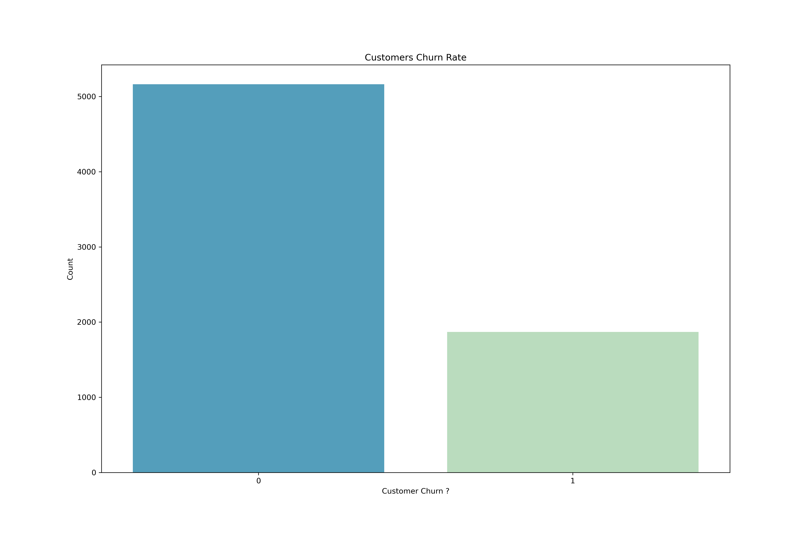
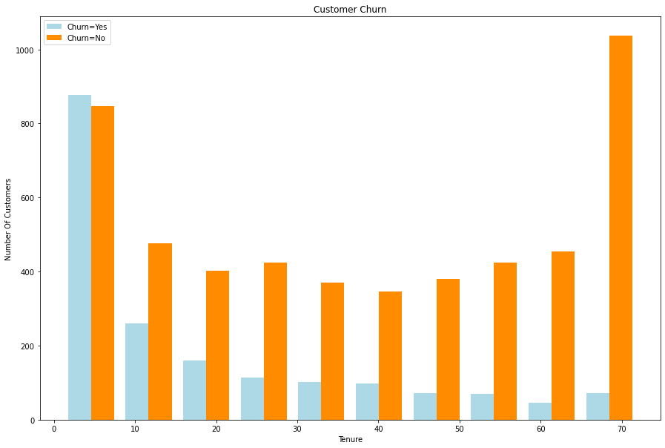
Churn Rate
26.6% customers churn from the company.
The customers who do not churn tend to stay for a longer tenure with the telecom company.

Slide 8
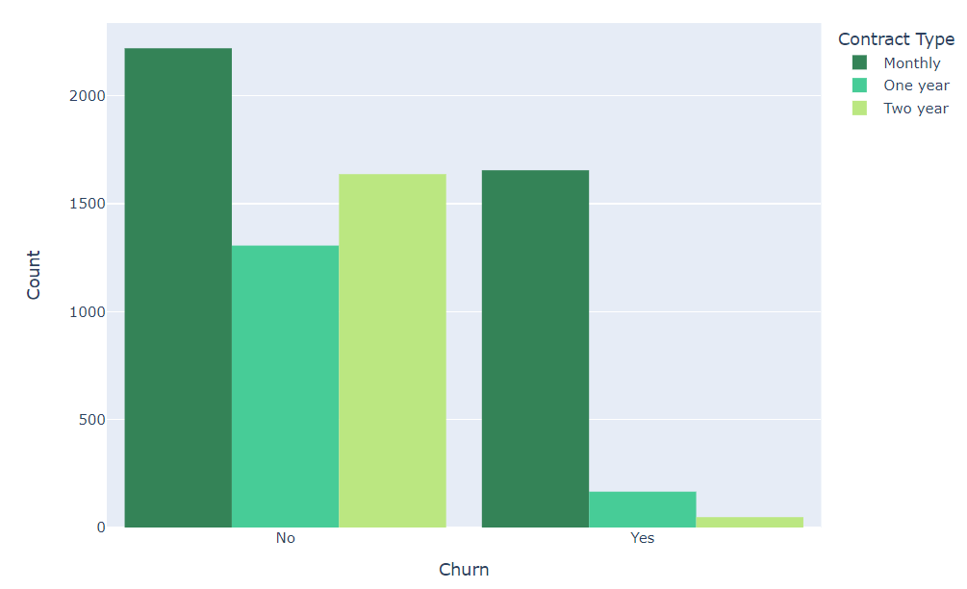
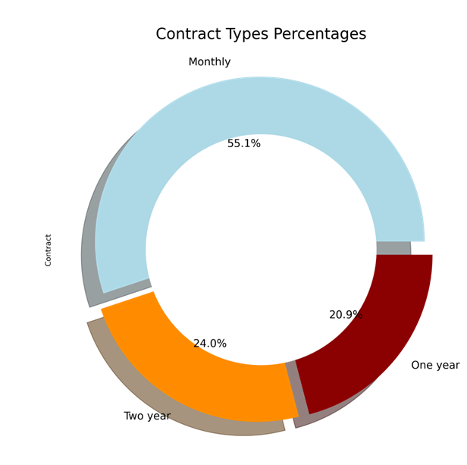
Customer Contract
- Most of Customers that leaves are with Monthly contracts ( 75% ).
- Customers with Longer period contracts are less likely to leave.
- Over all More than half customers have Monthly charged contracts.

Slide 9
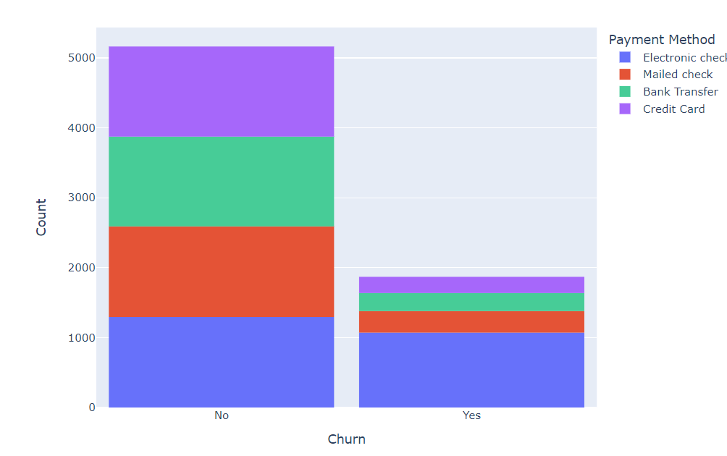
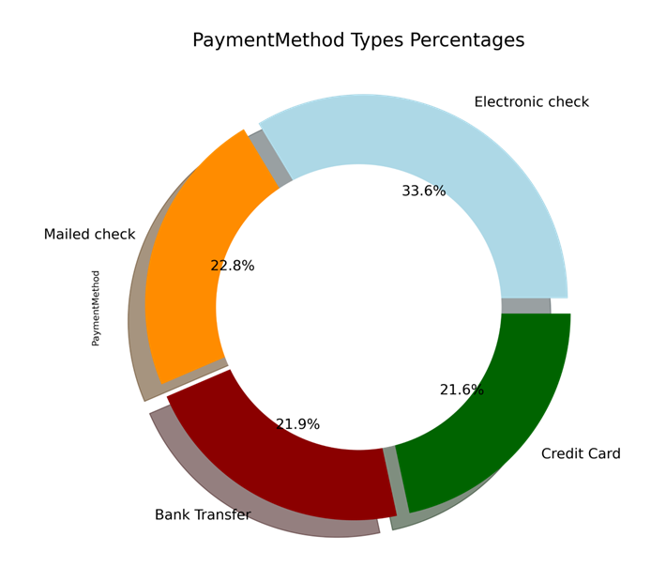
Customer Payment Method
- Customers with Credit-Cards or Bank Transfer or Mailed Check as Payment Method were less likely to leave.
- 33.7% Customers who left were having Electronic Check as Payment Method.

Slide 10
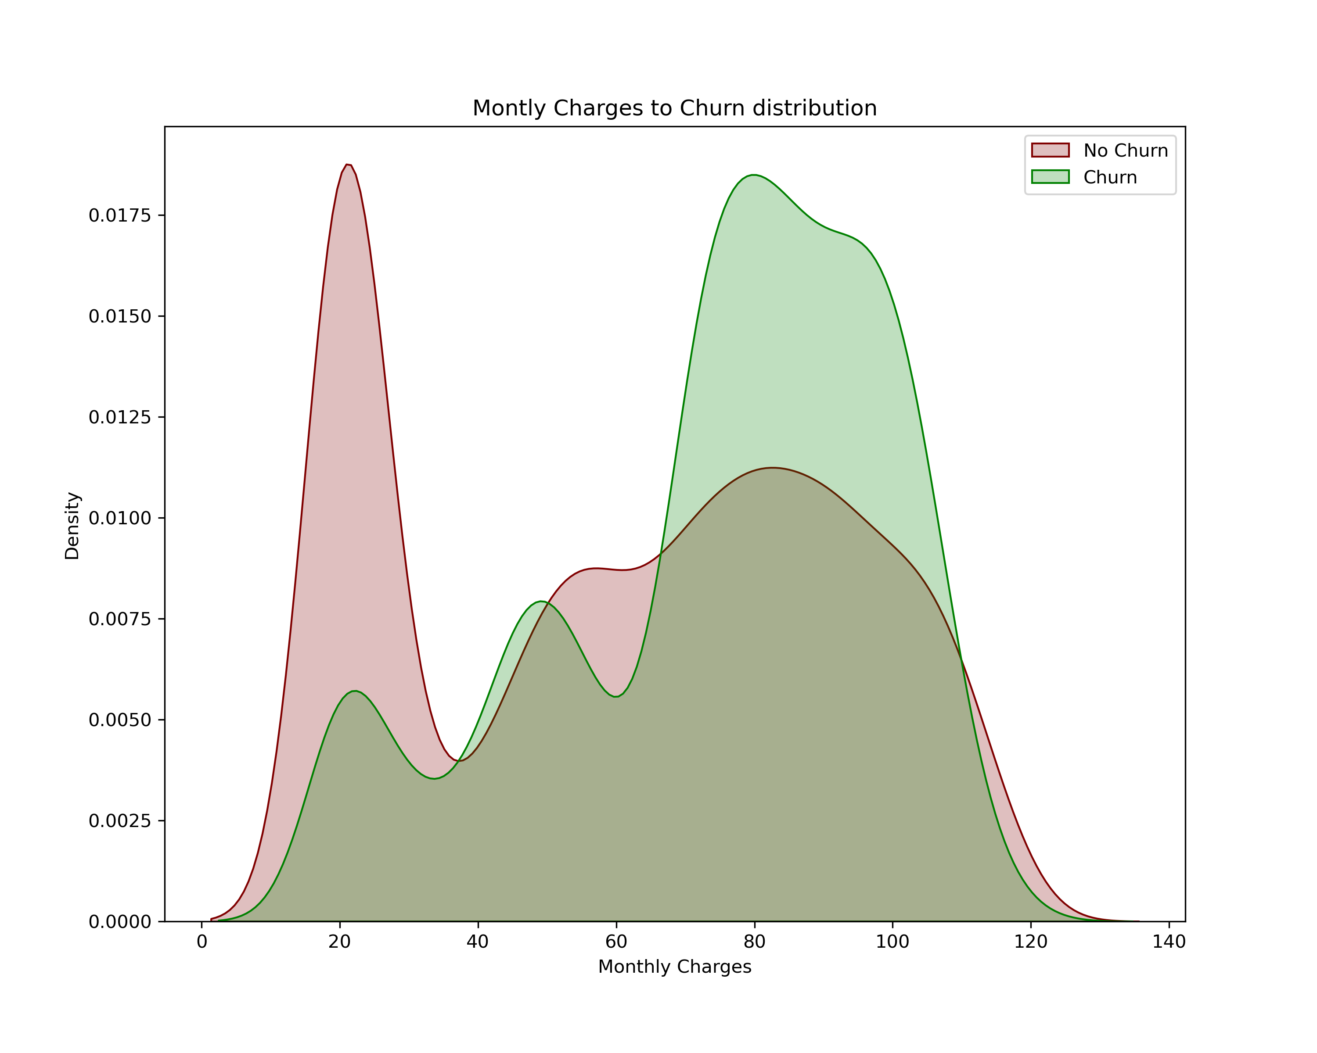
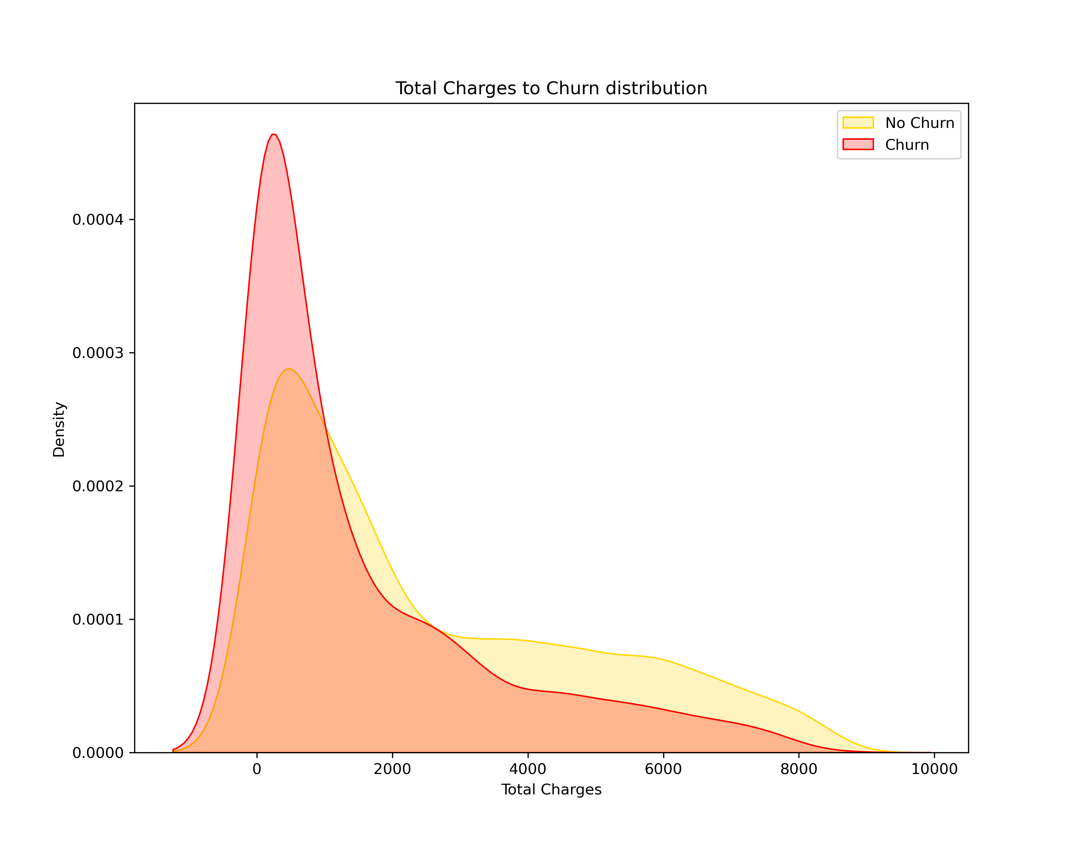
Monthly & Total Charges
- Customers with higher Monthly Charges are also more likely to churn
- Customers that leaves does not have high Total charges in general .

Slide 11
The Modeling

Slide 12
Different Models Accuracy
1
Logistic Regression : 0.847 %
2
Gradient Boosting : 0.845 %
3
CatBoost : 0.842 %
4
Random Forest : 0.832 %
5
Naive Bayes : 0.829 %
6
XGBoost : 0.825 %

Slide 13
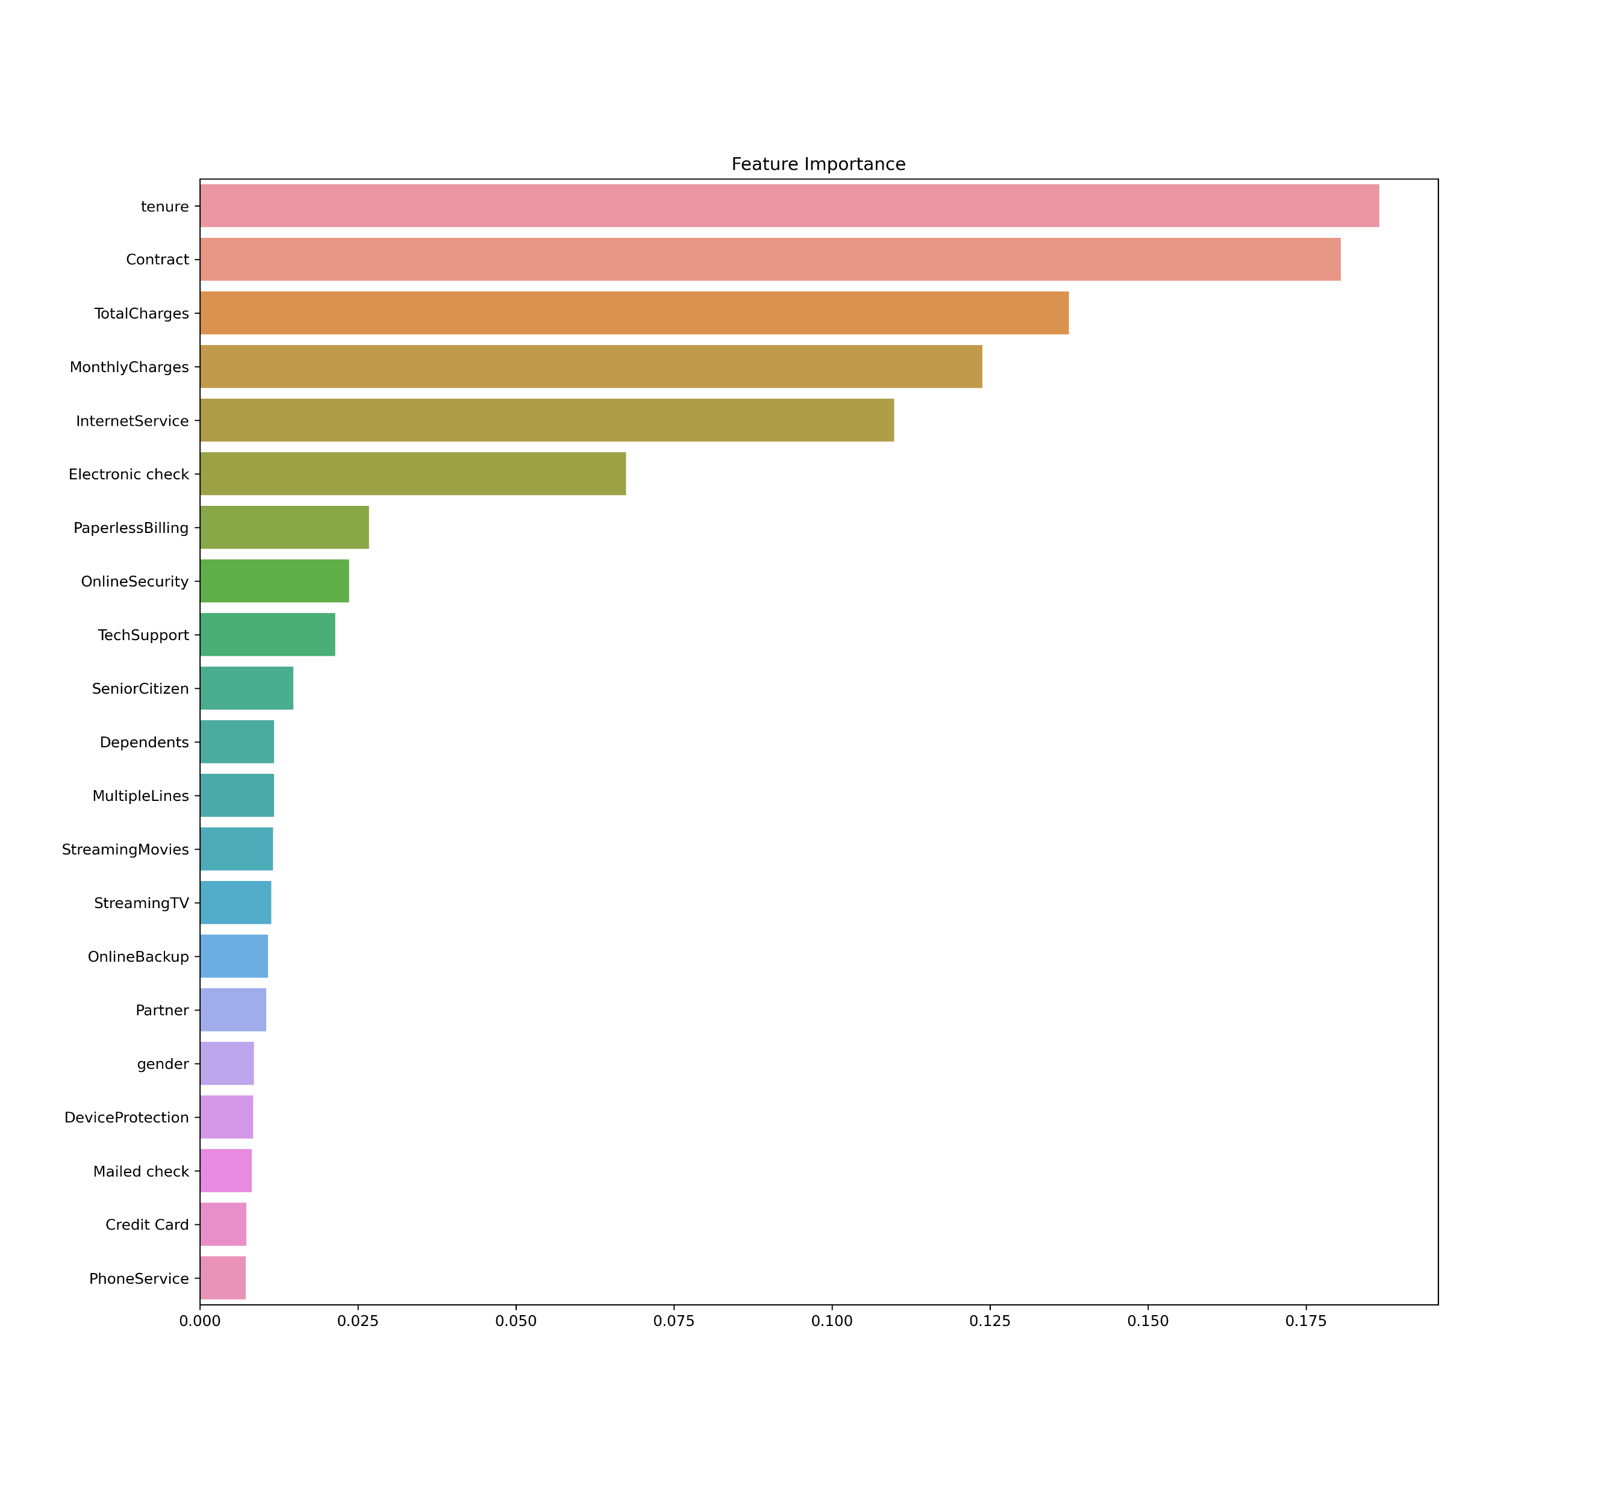
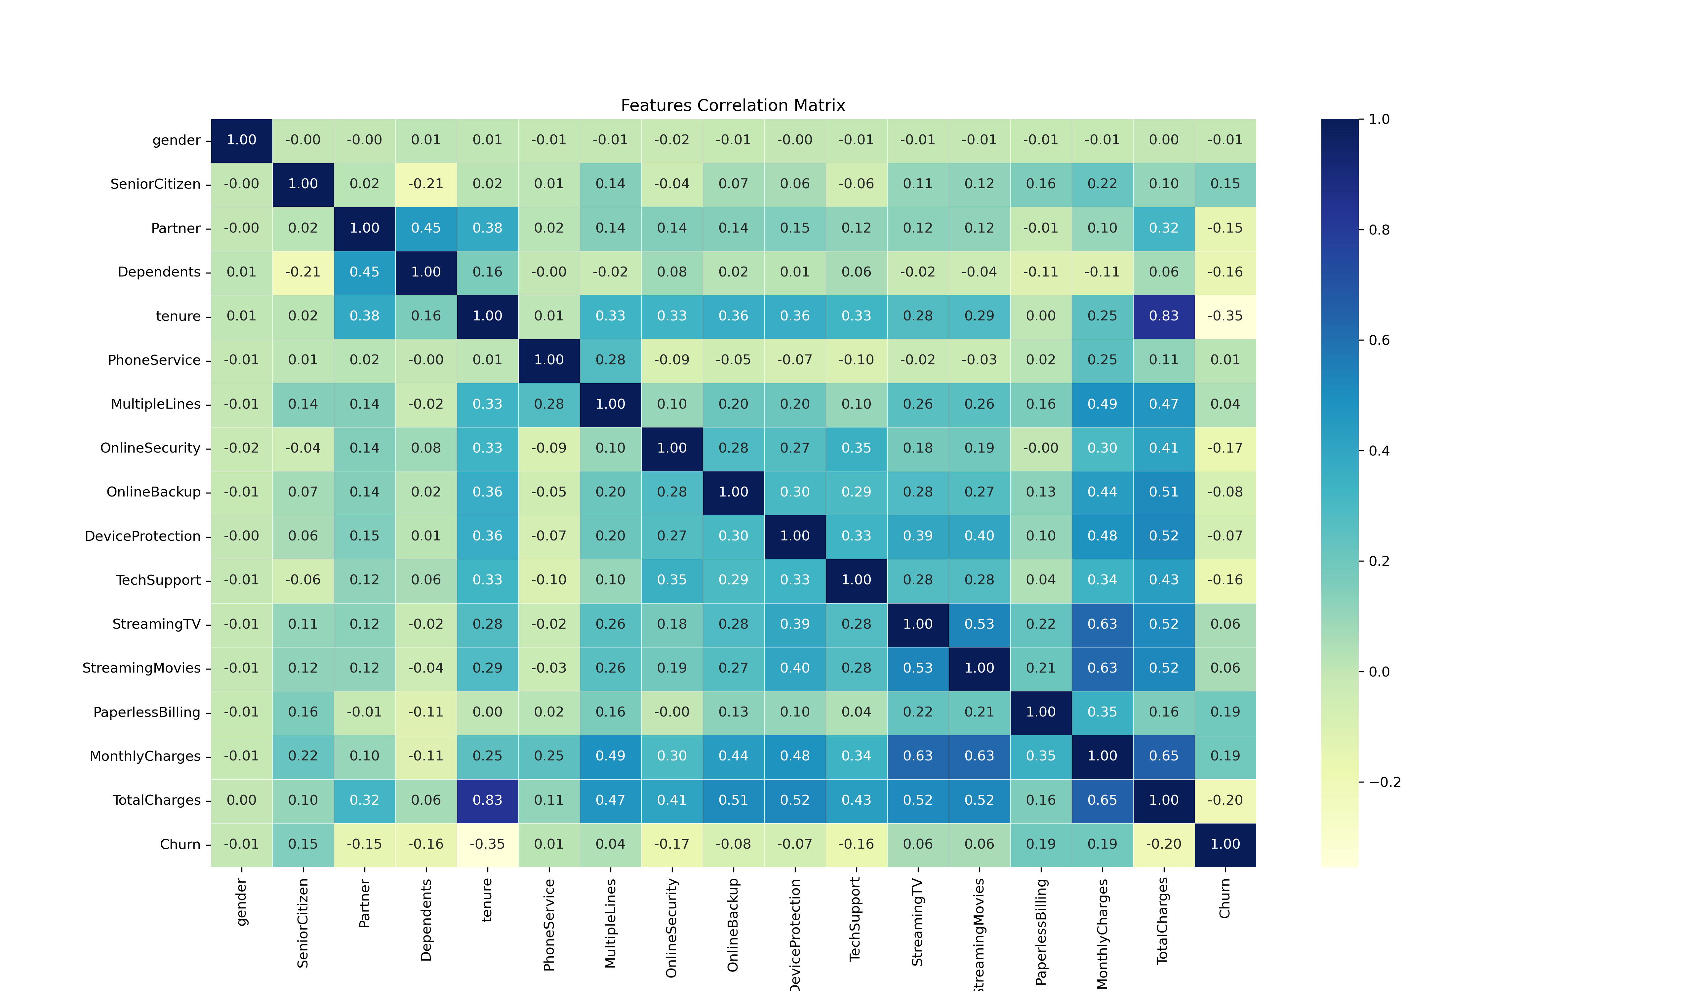
Correlation and Features Imporatnce

Slide 14
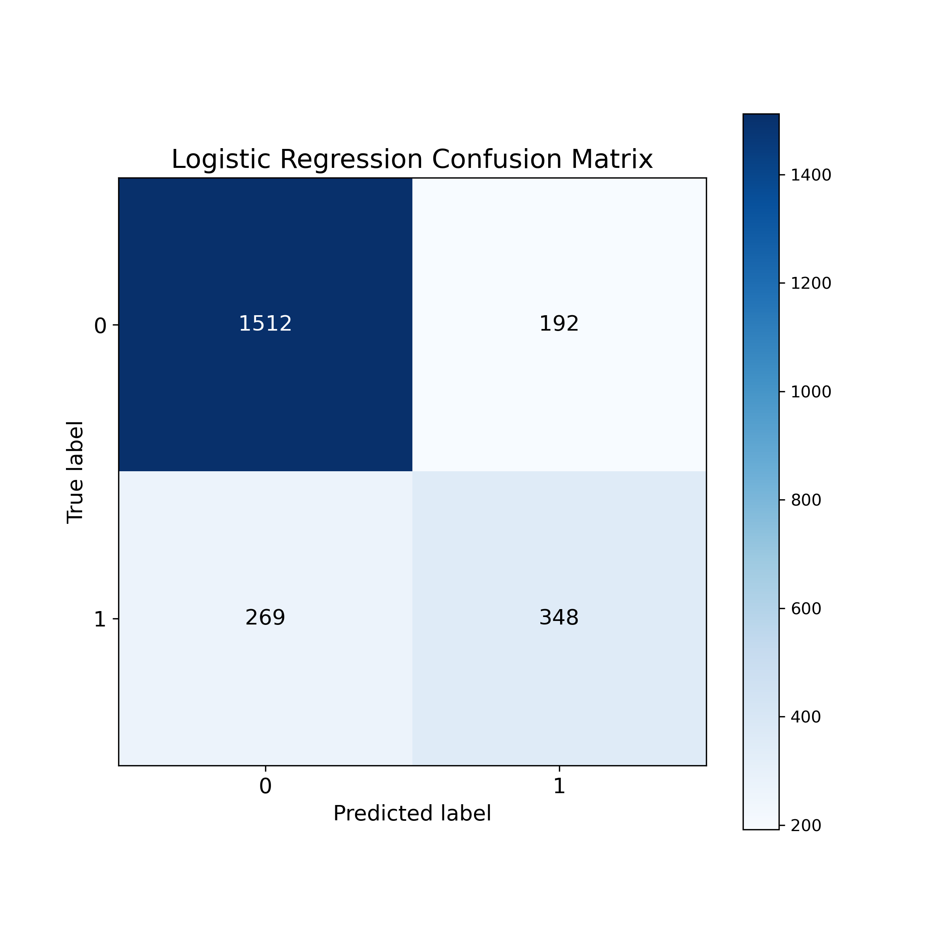
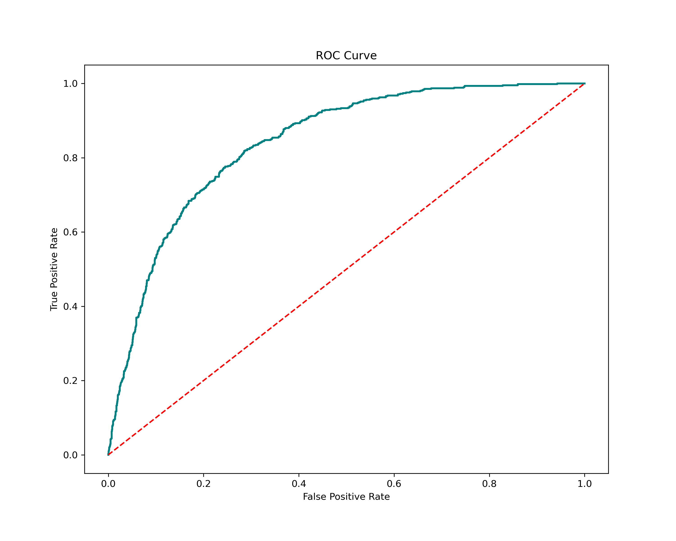
Confusion Matrix and ROC

Slide 15
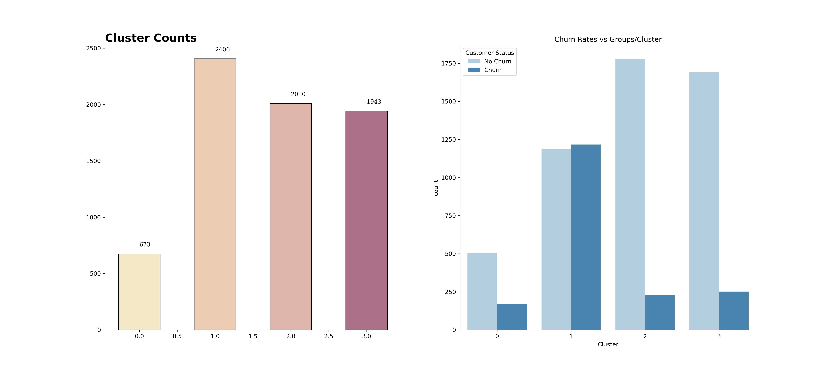
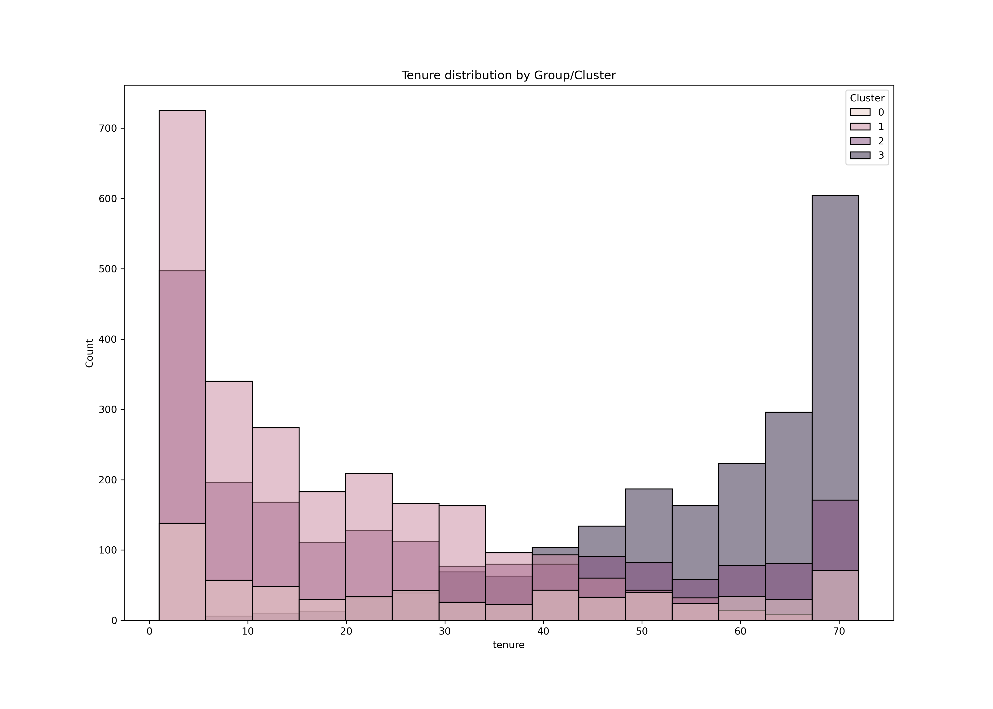
Clusters attributes

Slide 16
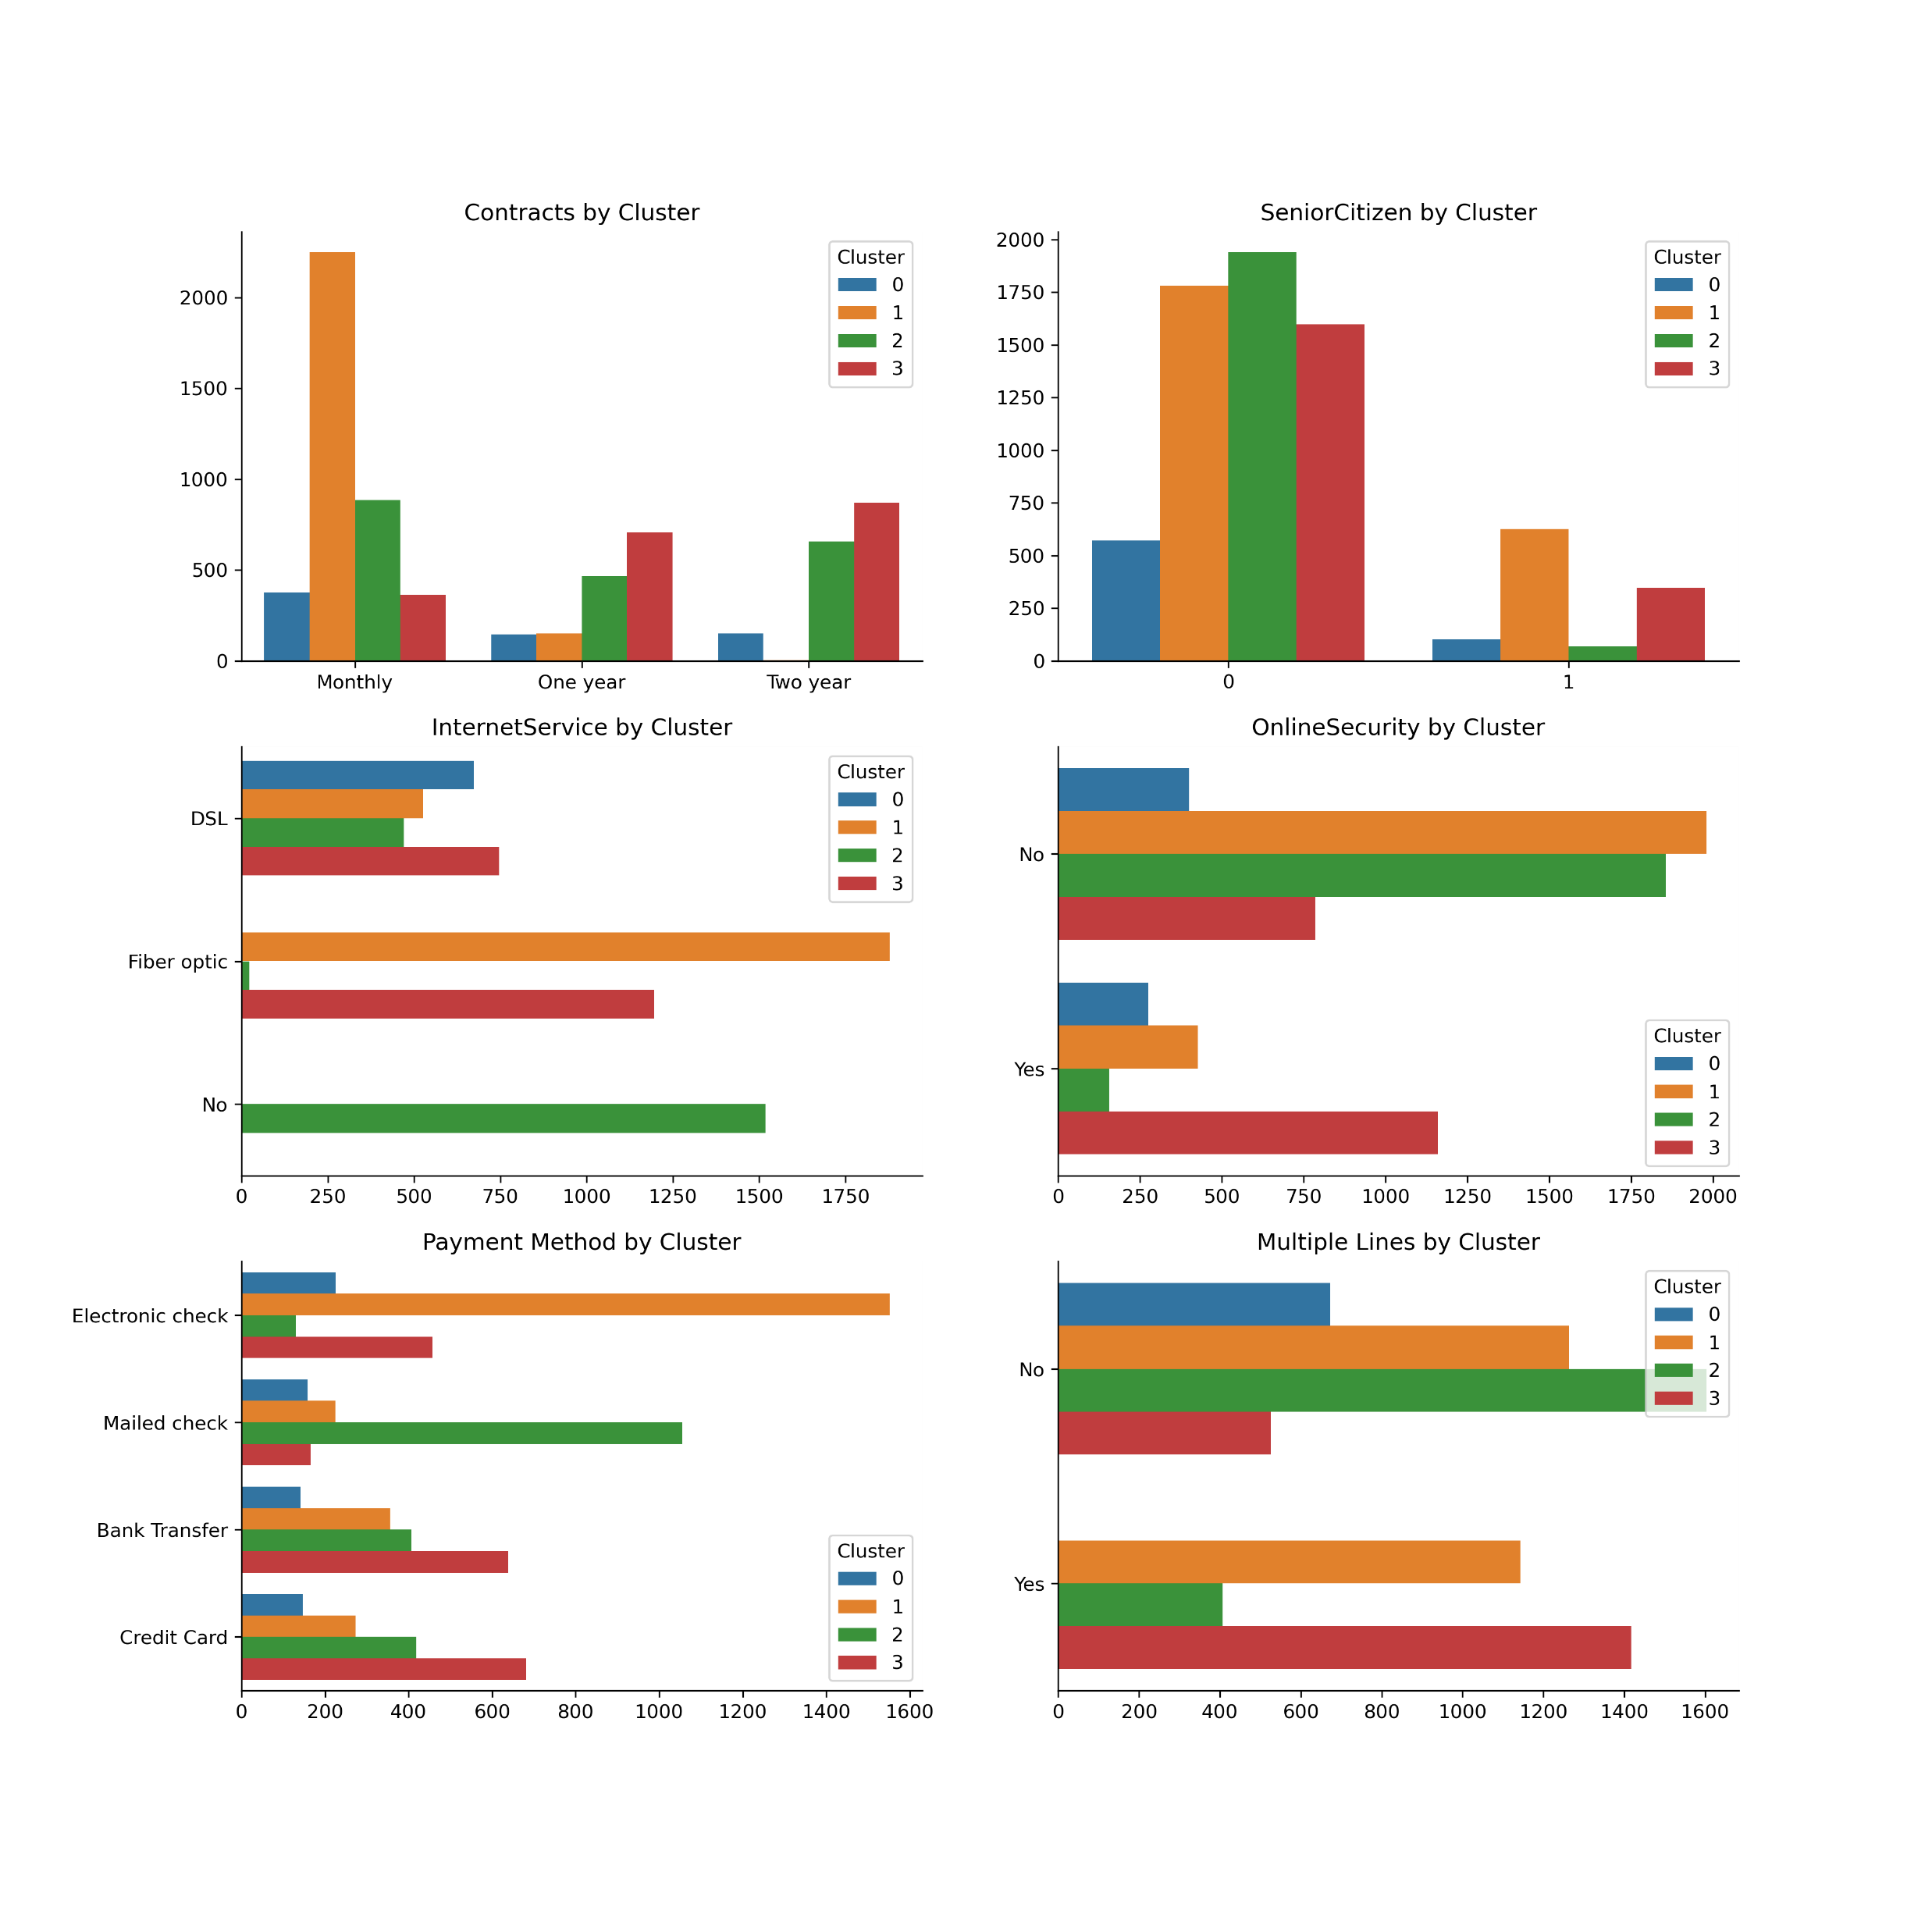
Clusters attributes

Slide 17
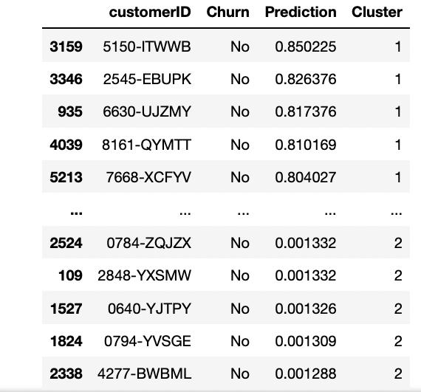
Prediction Output

Slide 18
Recommendations &
Future Work

Slide 19
Recommendations
Target Group of customers to pay close attention to has the following attributes :
Contracts
Internet Service
Age and Status
Monthly
Fiber Optic
New and Young
Tenure
Payment Method
Short
Electronic Checks

Slide 20
Future Work
Try to improve the accuracy of the model used by doing more feature engineering enhancements and hyper parameter tuning .
Try to implement more features into the model whether custom created or negotiate with the telco company to provide more features to analyze .
Build up an interactive user interface to show results and provide the ability to interact and target individual customers features.

Slide 21
THANK YOU

